Slide 1

SAP BTP ABAP on Cloud / RAP Training
DAY-18
Anubhav Oberoy
www.AnubhavTrainings.com
Follow excellence with sheer passion

Slide 2


DISCLAIMER
The training content and delivery of this presentation is confidential, and cannot be recorded, or copied and distributed to any third party, without the written consent of Anubhav Trainings

Slide 3

01
Attachment
02
Extensibility
03
Embedded Steampunk
04
Scenario
Notes:
https://pixabay.com/photos/san-francisco-transamerica-pyramid-1633203/

Slide 4
ALP Analytic List Page
An Analytical List Page (ALP) is a SAP Fiori element that allows users to analyze data and take action on it. It's a key component of SAP Fiori embedded analytics.
Here are some things you can do with an ALP:
Analyze data: Use KPIs, charts, tables, and visual filters to analyze data from different perspectives
Investigate root causes: Drill down to find root causes
Act on transactional content: Take action on transactional content
Build apps: Create apps that visualize and report data
Combine data: Combine transactional and analytical data using charts and tables
ALPs have a flexible layout that can be customized in a number of ways, including:
Sorting: Sort the work list
Page layout: Set page layout preferences
Filters: Set filters and save filter selections
Default views: Set default views
ALPs are organized into two sections: a header section for setting filters, and a content section for displaying charts and lists.
www.anubhavtrainings.com

Slide 5
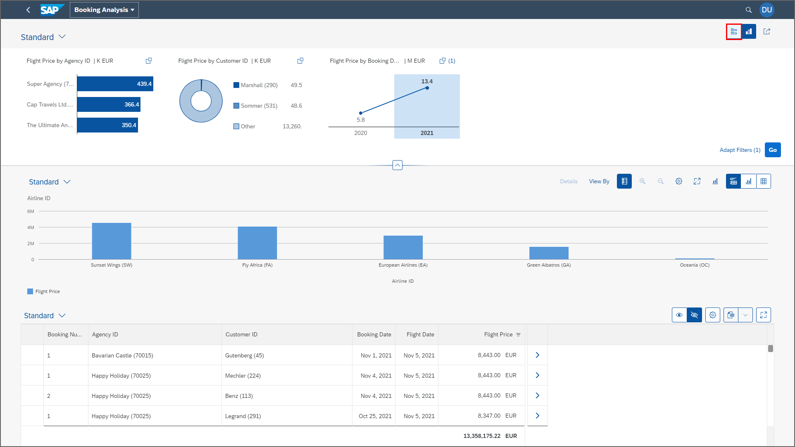
ALP
www.anubhavtrainings.com

Slide 6
Booking Consumption Analytics View
Booking Analytics CDS entity
Travel Analytics CDS entity
Carrier
Connection
/dmo/travel
/dmo/customer
/dmo/agency
Bookings

Slide 7
OVP – Overview pages
The Overview Page (OVP) in SAP is a data-driven app that provides users with a single page of information based on their role or domain. It helps users focus on important tasks by allowing them to quickly view, filter, and react to information.
Here are some things to know about the OVP:
Structure
The OVP has a header area and a content area. The content area displays cards that can contain charts, lists, tables, or text.
Cards
The OVP supports both standard and custom cards. Standard cards are entry-level views of the most relevant app data for a given topic or issue. Custom cards allow you to define the appearance and content of a card.
List cards
The OVP supports three types of list cards: list card, bar chart list card, and link list card.
Flavors
List cards can have two types of flavors: standard and bar. Standard flavor cards display items as numbers and text, while bar flavor cards display items as a combination of numbers, text, and a bar.
www.anubhavtrainings.com

Slide 8
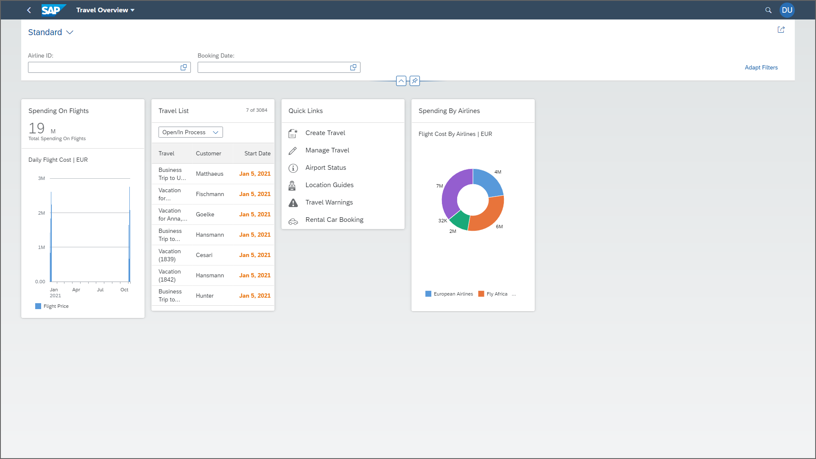
OVP
www.anubhavtrainings.com

Slide 9
Booking Consumption Analytics View
Booking Analytics CDS entity
Travel Analytics CDS entity
Carrier
Connection
/dmo/travel
/dmo/customer
/dmo/agency
Bookings

Slide 10
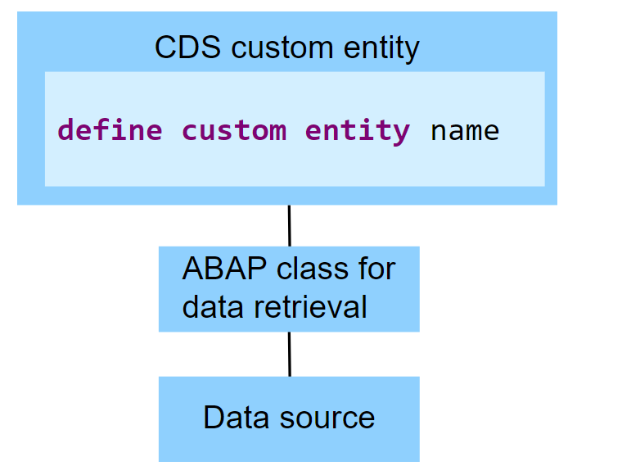
Custom Entities
A CDS custom entity allows developers to implement their own data retrieval using ABAP. A CDS custom entity is linked with an ABAP class and the data retrieval is executed on the application server. At the CDS level, only an interface is defined. Custom entities are used when data can't be accessed using SQL and the available CDS feature set.
The following image exemplifies the runtime of a CDS custom entity. It shows that the data retrieval is implemented by an ABAP class and the data source does not have to be a database table.
www.anubhavtrainings.com

Slide 11
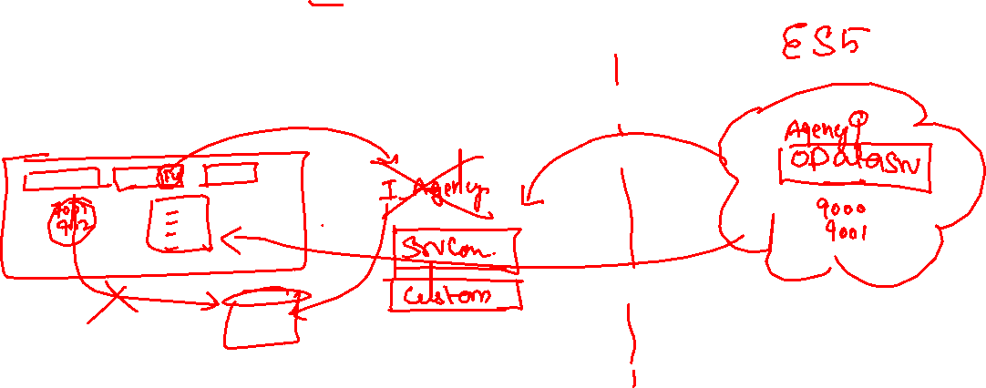
Reference Scenario – Custom Entity
In this exercise, we want to replace the travel agencies data of our managed travel app with the results of the remote OData service that provides different set of travel agencies from other system altogether. For this use case, we shall leverage the concept of a custom entity. In contrast to "normal" CDS views that read data from the database tables or other CDS views, the so-called custom entities act as a wrapper for a code-based implementation that provides the data instead. This use case involves following steps.
Creating the Service Consumption Model
Defining the Custom CDS Entity
Create a class that implements the query for the custom entity
Integrate the custom entity in MDE
www.anubhavtrainings.com

Slide 12
Attachments
Starring SAP ABAP on Cloud release 2208 SAP started direct support for attachments (PDF, Excel, Images, TXT, Word) including binary files. We must need to create a database table with atleast following columns
Attachment (Data type: RAWSTRING length 0)
Mimetype (Document type, String128)
Filename (Document Name, String128)
Travel
Attachments
1 n
www.anubhavtrainings.com

Slide 13
Steps
Create new attachment table according to need and design
Create a Interface Entity for the attachment table and mark our attachment field with special attachment annotation, So the RAP framework can treat it as an attachment accordingly.
Add annotations for admin fields, and user labels.
Create composition of our attachment table with travel entity like we had the composition of booking with travel entity.
Create a projection view for attachment
Relationship between Travel processor view with attachment processor view entity
Enhance the BDEF with attachment like booking
Also expose the attachment functionality with draft to processor in behavior projection for processor
Expose the entity of attachment processor in service definition
Republish the OData V4 binding
Add the metadata extension for attachment scenario and link a new facet in travel for attachment table
Testing
www.anubhavtrainings.com

Slide 14
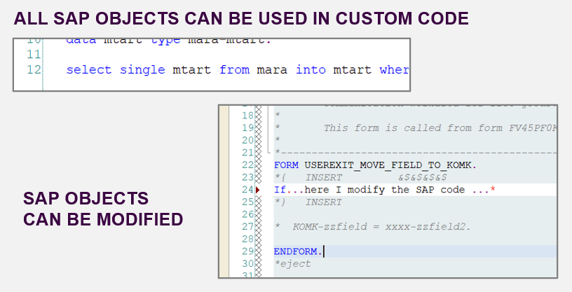
From classic ABAP extensions to ABAP Cloud development
<>
www.anubhavtrainings.com

Slide 15
What is ABAP Cloud Development Means:
Use public SAP APIs (local or remote) released by SAP to access SAP functionality and SAP data
Use public SAP extension points released by SAP to extend SAP objects. Modifications to SAP standard objects are not supported (applies to S/4HANA Cloud system)
Use of Adt (ABAP development tools) on eclipse
Use Steampunk (RAP – Restful Application Programming model) to build Fiori Applications and services. SAP technologies like Dynpro and webdynpro are not released for cloud development.
www.anubhavtrainings.com

Slide 16
What is Embedded Steampunk
If we are using SAP BTP to develop side by side extensions, full stack SAP applications in BTP (Steampunk)
If we are using In-app Developer extensibility with released objects in S/4HANA (all editions) with RAP (Embedded Steampunk)
If you using RAP and enhancing your Standard SAP Applications delivered by SAP in S/4HANA system, the recommended approach is Embedded Steampunk.
Every Customer using S/4HANA can decide whether they want to use new approach (embedded Steampunk) or classic extension approach (BADI) @ Object level
This can be done by switching a setting @ object level.
www.anubhavtrainings.com

Slide 17
Steps
Create new attachment table according to need and design
Create a Interface Entity for the attachment table and mark our attachment field with special attachment annotation, So the RAP framework can treat it as an attachment accordingly.
Add annotations for admin fields, and user labels.
Create composition of our attachment table with travel entity like we had the composition of booking with travel entity.
Create a projection view for attachment
Relationship between Travel processor view with attachment processor view entity
Enhance the BDEF with attachment like booking
Also expose the attachment functionality with draft to processor in behavior projection for processor
Expose the entity of attachment processor in service definition
Republish the OData V4 binding
Add the metadata extension for attachment scenario and link a new facet in travel for attachment table
Testing
www.anubhavtrainings.com

Slide 18
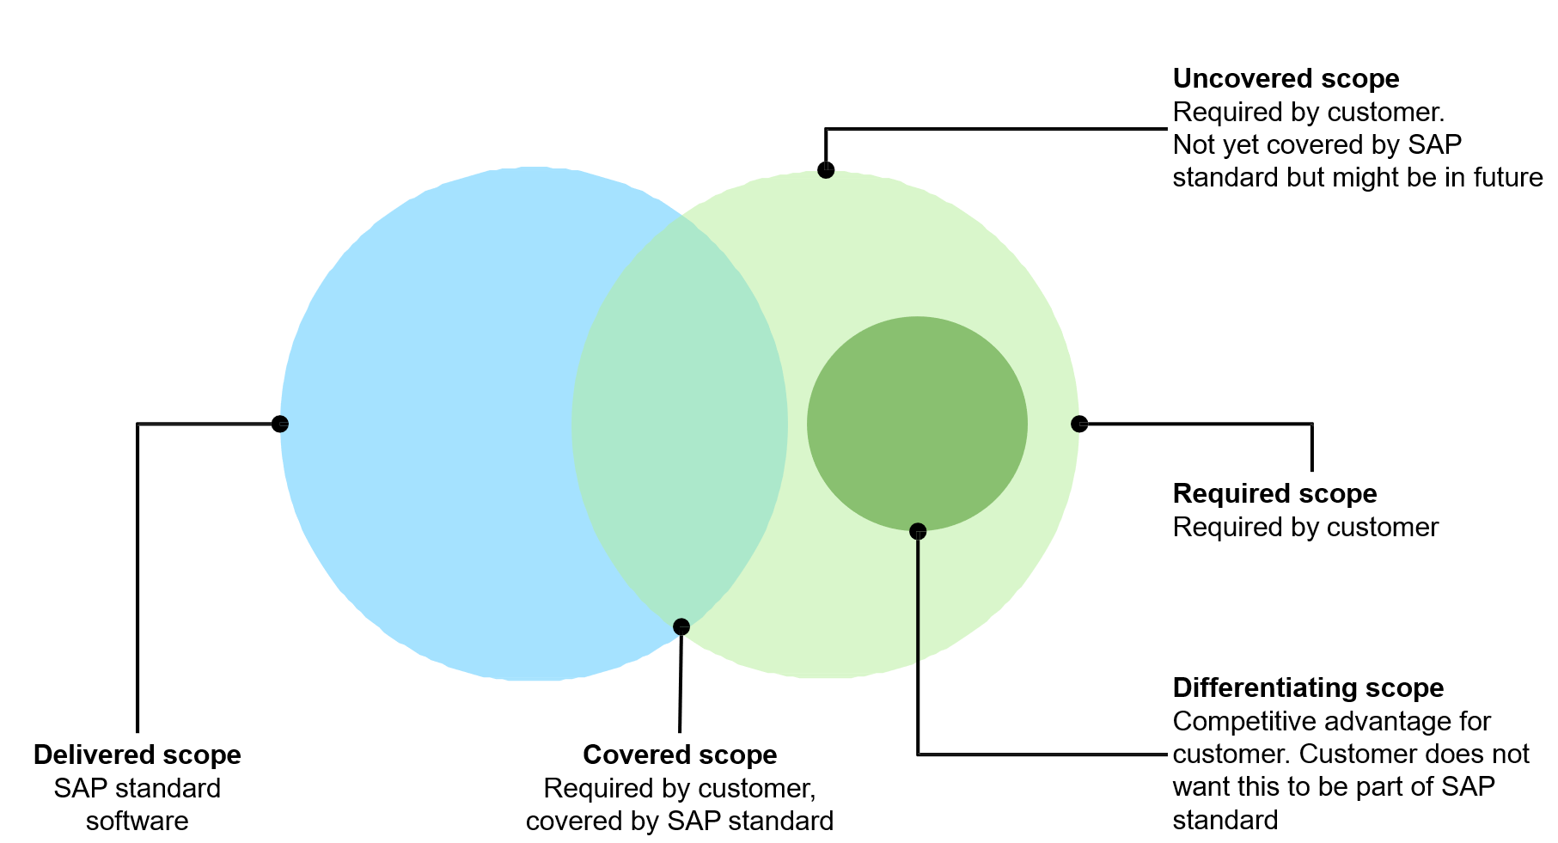
What is an Extension
We all know that standard SAP software doesn’t cover the scope of all the company business processes. There is always a need for a new app, a new report, or a new functionality. SAP partners and customers have been traditionally building extensions on SAP ECC system using ABAP code. However, with SAP S/4HANA and customer’s digital transformation journey towards cloud, we need a more robust yet loosely coupled extensibility model.
www.anubhavtrainings.com

Slide 19
Drawbacks of existing Extensions
Traditionally, SAP partners and customers have been using classic ABAP extensibility to extend their ERP solution.
Classic Extensibility (aka classic ABAP custom development) in SAP S/4HANA (or in SAP ECC):
Allows you to use classic development tools and techniques (e.g., transaction SE80, Eclipse IDE, BAdIs etc.)
Very rich of features and functions.
Extremely flexible and even allows you to modify SAP code itself.
Although, being very powerful, flexible, and popular, classic extensibility has some major drawbacks.
One of them is High Upgrade Efforts!
The missing clear interface between SAP code and extensions might lead to issues in the extensions during upgrades. As a result, upgrades require high planning, regression test, and adaption efforts, which is one of the reasons why customers delay upgrades.
Example:
You have used an SAP object that is not whitelisted by SAP in your extension. After an upgrade the used SAP Object has been changed or deleted. Now you will have to adjust the extension thus upgrade is delayed.
www.anubhavtrainings.com

Slide 20
What is Clean Core and its Benefits
Clean core is an extension methodology in which
Extensions are kept strictly separate from the SAP application.
Extensions access SAP business objects only through well defined, upgrade-stable interfaces
By following clean core paradigm, you make sure that
Extensions do not break an upgrade and upgrades do not break an extension.
Extensions do not create a problem when you migrate from SAP S/4HANA on-Premise to SAP S/4HANA Cloud
SAP’s rationale behind the “clean core” paradigm is simple – Allow customers to extend their SAP S/4HANA software while making the software updates eventually non-events.
Clean core paradigm is the back-bone of S/4HANA new extensibility model. It provides following benefits
Reduce TCO
Make upgrades non-events from a custom code point of view
Reduce test efforts for business users
Reduce adaption efforts for developers
IT service providers can offer upgrade projects at a fixed price
Speed and Innovation
Absorb innovation delivered by SAP at a faster rate
React fast on changing business requirements
Be cloud ready
Lay the foundation today to move to the cloud from a custom extension perspective
www.anubhavtrainings.com

Slide 21
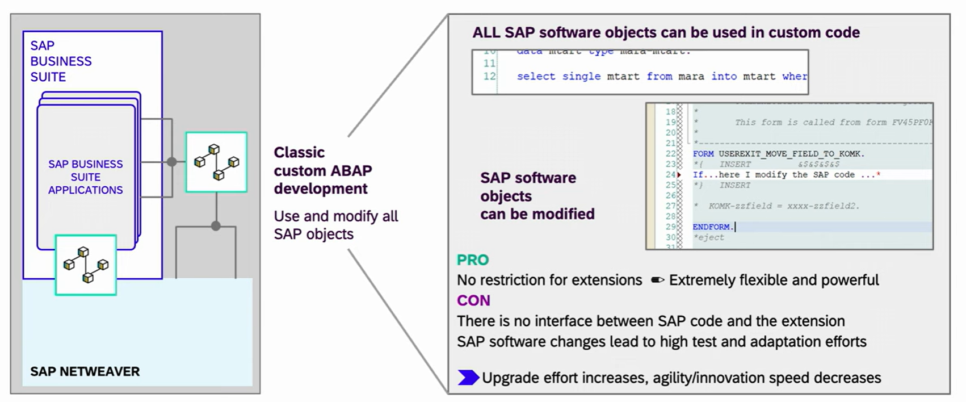
From classic ABAP extensions to ABAP Cloud development
<>
www.anubhavtrainings.com

Slide 22
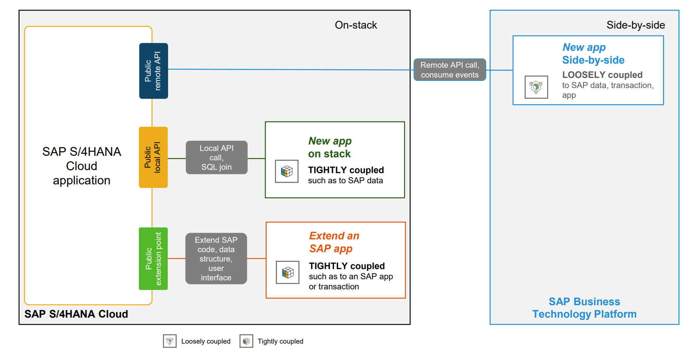
Extensibility Patterns
www.anubhavtrainings.com

Slide 23
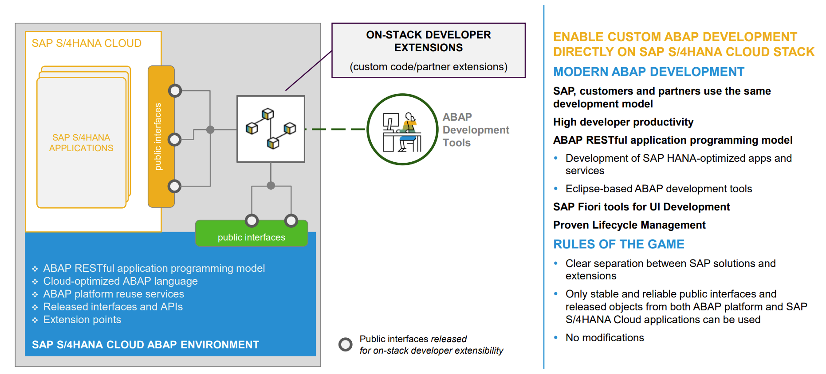
Extension Persona - Developer
www.anubhavtrainings.com

Slide 24
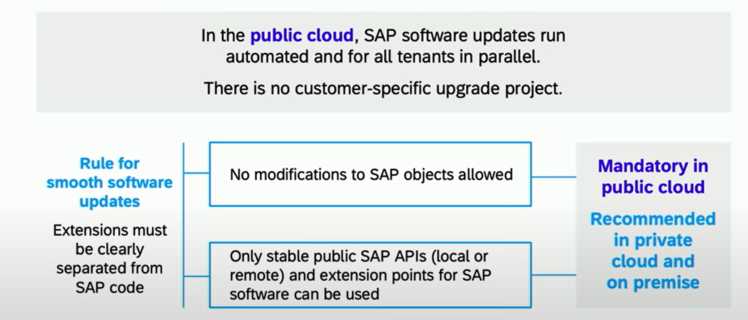
What is ABAP Cloud Development Means:
Use
Use public SAP APIs (local or remote) released by SAP to access SAP functionality and SAP data
Use
Use public SAP extension points released by SAP to extend SAP objects. Modifications to SAP standard objects are not supported (applies to S/4HANA Cloud system)
Use
Use of ADT (ABAP development tools) on eclipse
Use
Use Steampunk (RAP – Restful Application Programming model) to build Fiori Applications and services. SAP technologies like Dynpro and webdynpro are not released for cloud development.
www.anubhavtrainings.com

Slide 25
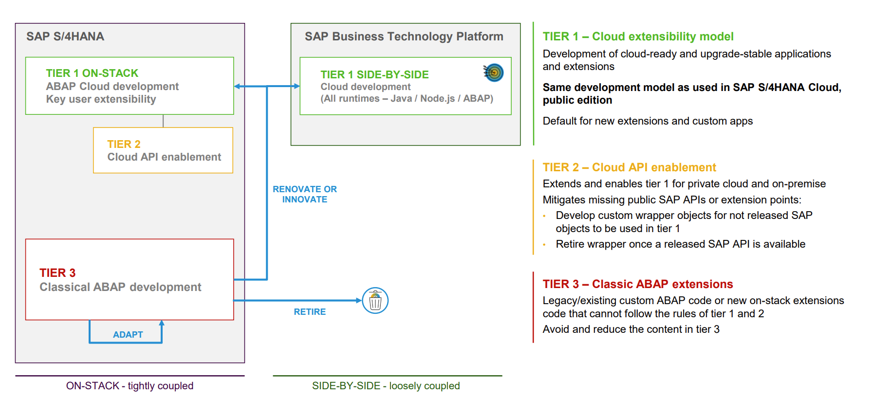
3-tier extensibility model for S/4HANA
www.anubhavtrainings.com

Slide 26
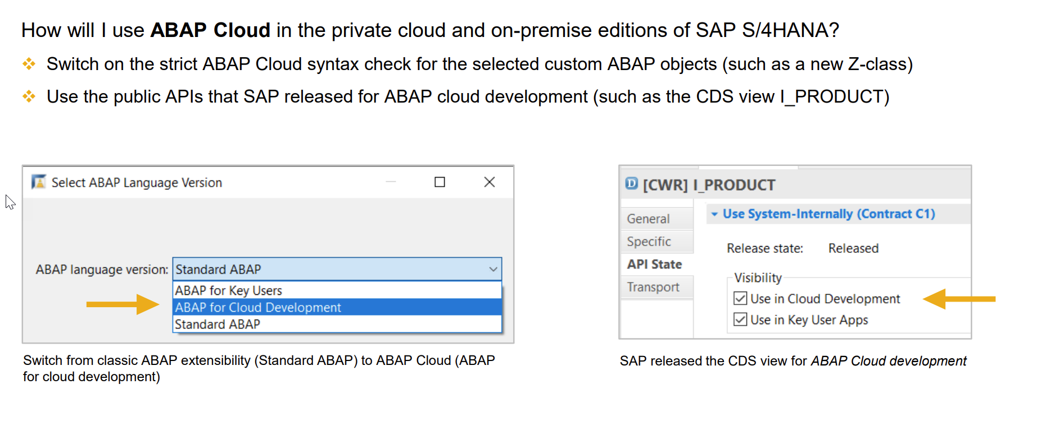
What is Embedded Steampunk
The term Embedded steampunk means running the ABAP on Cloud Environment within SAP S/4HANA enviornment
If we are using SAP BTP to develop side by side extensions, full stack SAP applications in BTP (Steampunk)
If we are using In-app Developer extensibility with released objects in S/4HANA (all editions) with RAP (Embedded Steampunk)
If you using RAP and enhancing your Standard SAP Applications delivered by SAP in S/4HANA system, the recommended approach is Embedded Steampunk.
Every Customer using S/4HANA can decide whether they want to use new approach (embedded Steampunk) or classic extension approach (BADI) @ Object level, This can be done by switching a setting @ object level.
www.anubhavtrainings.com

Slide 27
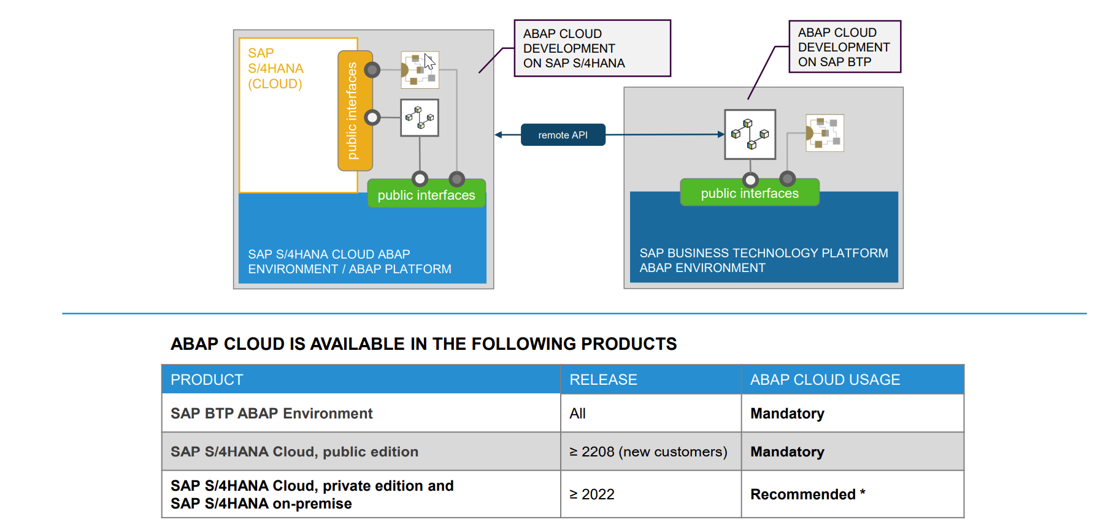
Availability – ABAP on Cloud - Steampunk
www.anubhavtrainings.com

Slide 28

Demo
www.anubhavtrainings.com

Slide 29
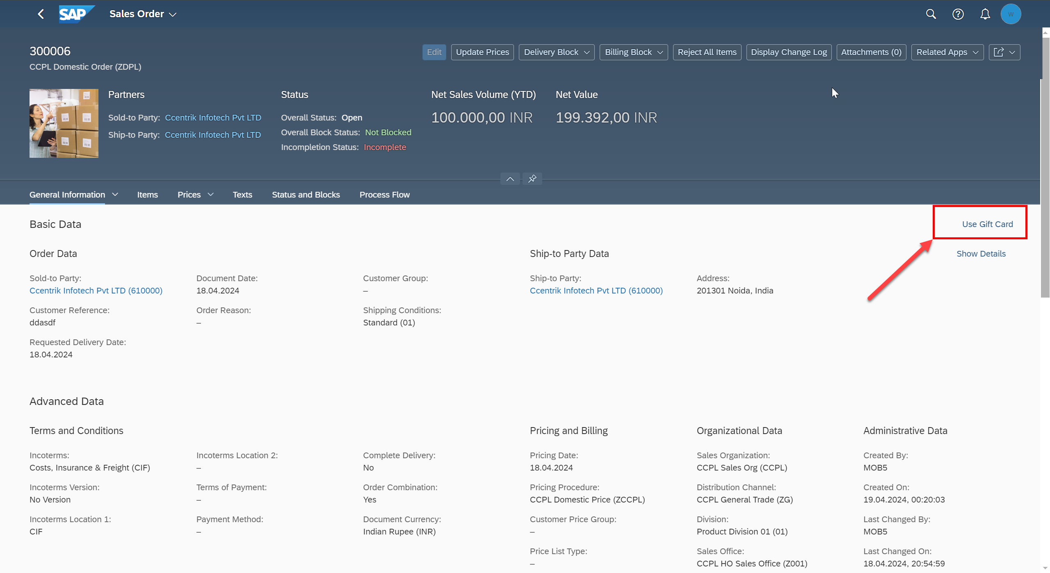
Scenario
www.anubhavtrainings.com

Slide 30
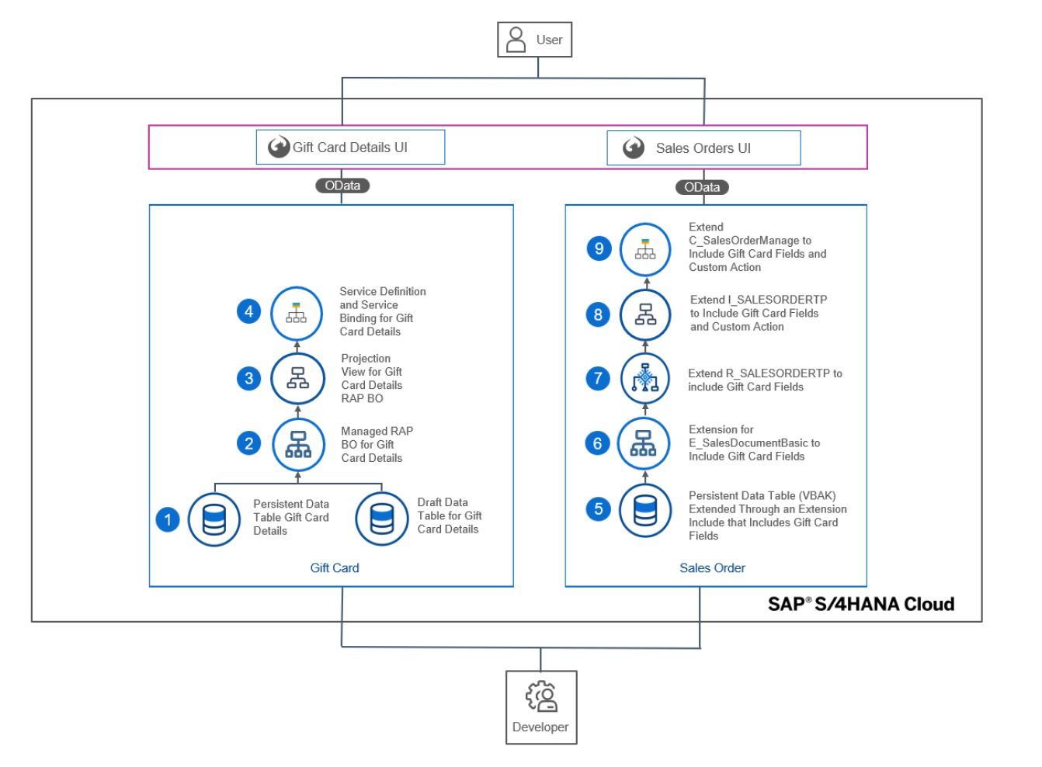
Development Objects
www.anubhavtrainings.com

Slide 31





















Slide 32

Finding RAP extension objects in ADT and HUB
As a developer in our company how can we ensure or find the released SAP object (CDS views, APIs, RAP business object) so when a requirement comes to me for enhancing standard Fiori Apps or functionality in S/4HANA, I can use the embedded Steampunk for developer extensibility.
Directly using ADT – appl:sd api:extend_in_cloud_development
Refer the documentation on https://api.sap.com
Example of Sales order
SAP Standard Fiori App
I_SalesOrderTP
C_SalesOrderManage
R_SalesOrderTP
www.anubhavtrainings.com

Slide 33
Activate standard app
We need to find the sales order application in SAP Fiori App reference library
We need to check its configuration
Activate the Standard Fiori App using Rapid Fiori Activation Task list and generate the role
Will activate all the odata services, and configure catalog and group with the role so that our user can access the Fiori apps.
Tcode: STC01
Tasklist: SAP_FIORI_CONTENT_ACTIVATION
Role: SAP_BR_INTERNAL_SALES_REP
Go to PFCG and assign the role ZSAP_BR_INTERNAL_SALES_REP
Assign the role to our user to access this Fiori app
Make sure that in SPRO all the pricing conditions, pricing procedure and mapping of Sales org with procedure in tcode OVKK is maintained – Functional consultant
Test Data: if you are using Anubhav training system to demo this scenario use below test data:
Order Type: ZDPL
Sales Organization: CCPL
Distribution Channel: ZG
Division: 01
Ship to Party: 610000
Material: 167
Testing – Create sales order - /n/ui2/flp
server@anubhavtrainings.com
Subscribe an S/4HANA 2023 OP system access @ 40 USD per month
www.anubhavtrainings.com

Slide 34
Certification
https://training.sap.com/certification/validity?keepQueryParams=1&keepRequestMethod=1
https://training.sap.com/certification/c_abapd_2309-sap-certified-associate--back-end-developer---abap-cloud-g/?
C_ABAPD_2309
SAP Certified Associate – Back-End Developer - ABAP Cloud
Raj.shettyhyd@gmail.com
DYOR
Anubhav.abap@gmail.com
www.anubhavtrainings.com

Slide 35
www.anubhavtrainings.com
Thank You
End of Day 18
www.anubhavtrainings.com

Slide 36


We’re committed to empower you to be
#FutureReady
through powerful training solutions.
We build the workforce of the future.
250+
Corporate Clients
30,000+
Learners Trained
25000+
Learners Placed
FREE WEBINARS
Sign up for free webinars with industry experts every fortnight!
Enroll Now!
Contact us today!
https://anubhavtrainings.com

